Slide 1
Chicago Crash Data Let’s get wrecked!
Romi Sinnigen
Andrew Baker
Jonathan Hicks
Andrew Bankston

Slide 2

Hypotheses
There will be more wrecks at night when it is dark
There will be more wrecks during the holidays
Fatalities are related to cost of damage
There will be more fatalities in slower speed limits zones
There is a relationship between crash count and traffic way type
Road way types do not have a strong effect on the type of wrecks that occur
There would be more wrecks around high schools
There will be more wrecks facing west towards the sunset

Slide 3
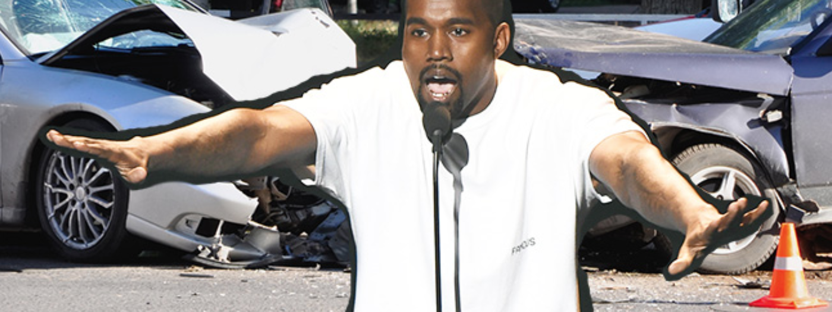
Hypotheses and data breakdown

Slide 4
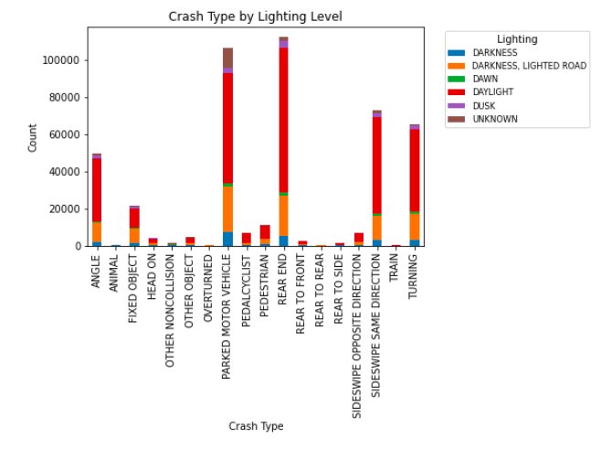
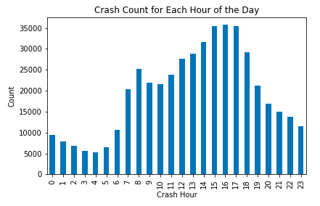
There will be more wrecks at night when it is dark
Crash count is significantly higher during daylight hours (red bar)
From the hours of 7am to 7pm we can see the highest counts of crashes.

Slide 5
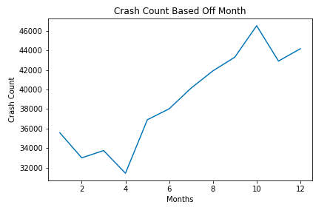
There will be more wrecks during the holidays
There is a clear spike in crash count when we reach October through January.
We cannot assume causation, but the correlation would have us believe that more wrecks occur around the holidays.

Slide 6
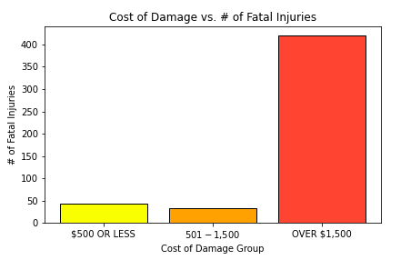
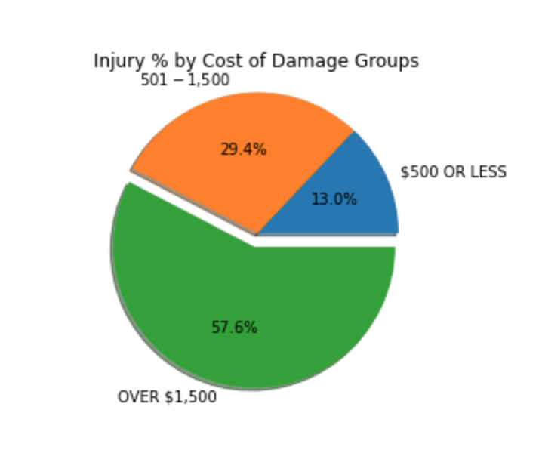
Fatalities are related to cost of damage
57.6% of injuries fall within the damage group of over $1,500.

Slide 7
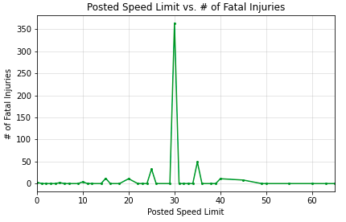
There will be more fatalities in slower speed limits zones
Majority of fatal injuries are in areas where the posted speed limit was 30mph.
This could be due to the fact that people were speeding in residential areas which are prone to having more parked cars, dips, lights, stop signs, etc. as compared to areas with faster speed limits like freeways.

Slide 8
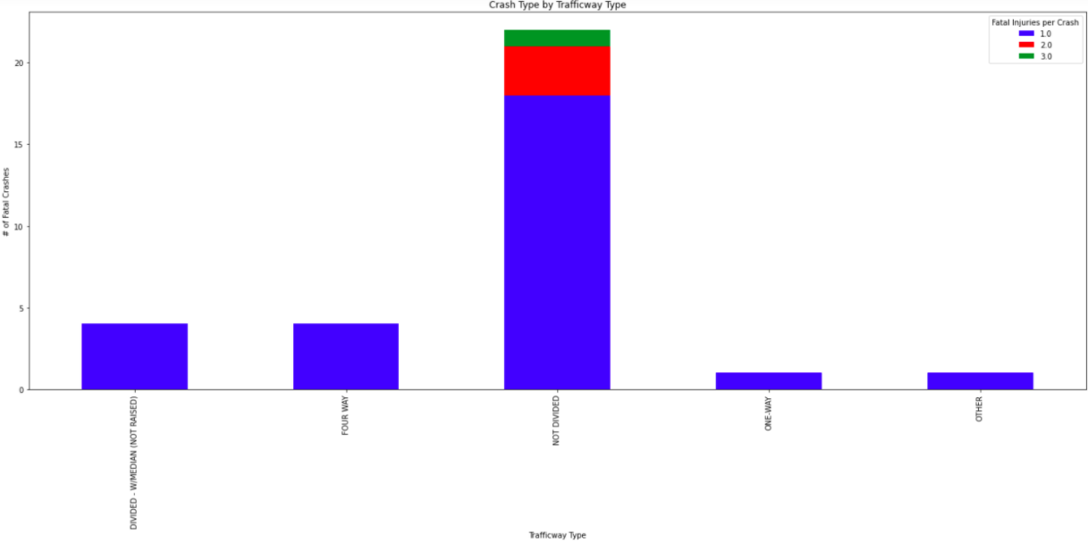
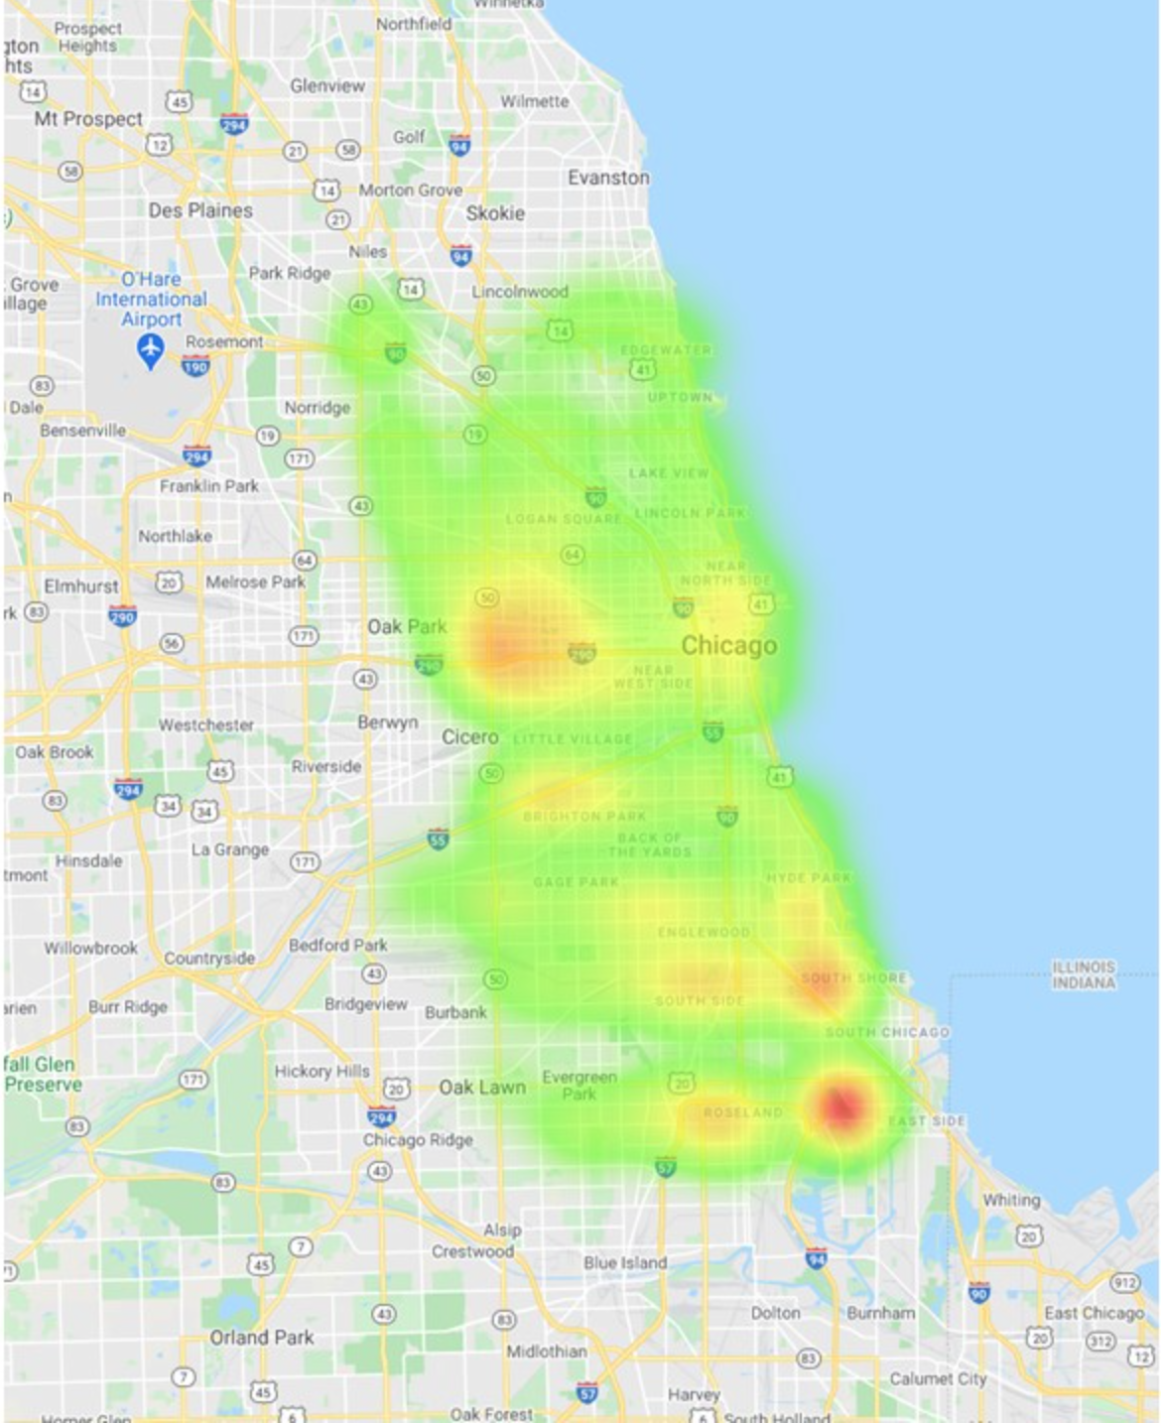
There is a relationship between crash count and traffic way type
Majority of wrecks happen in a non divided traffic way.
A two lane road with a painted double yellow dividing them

Slide 9
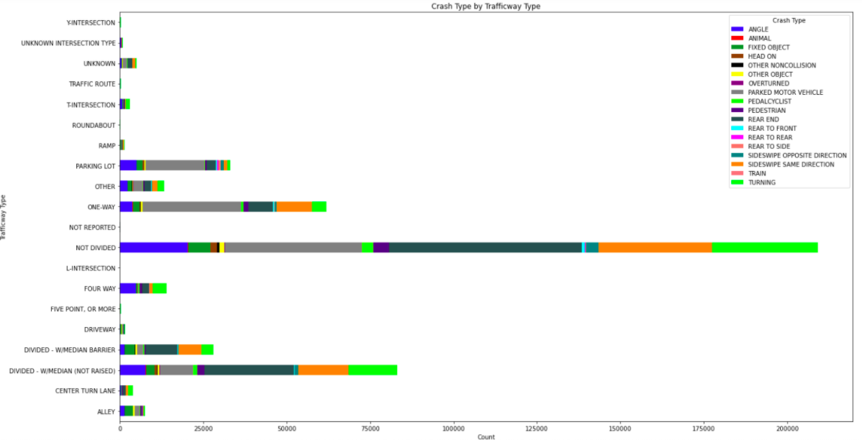
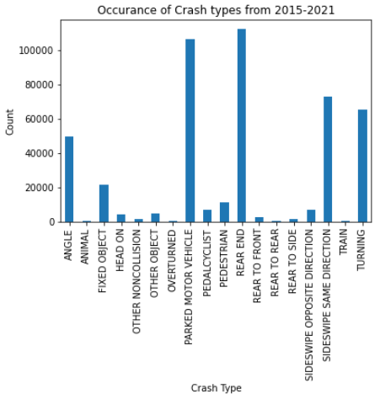
Road way types do not have a strong effect on the type of wrecks that occur

Slide 10
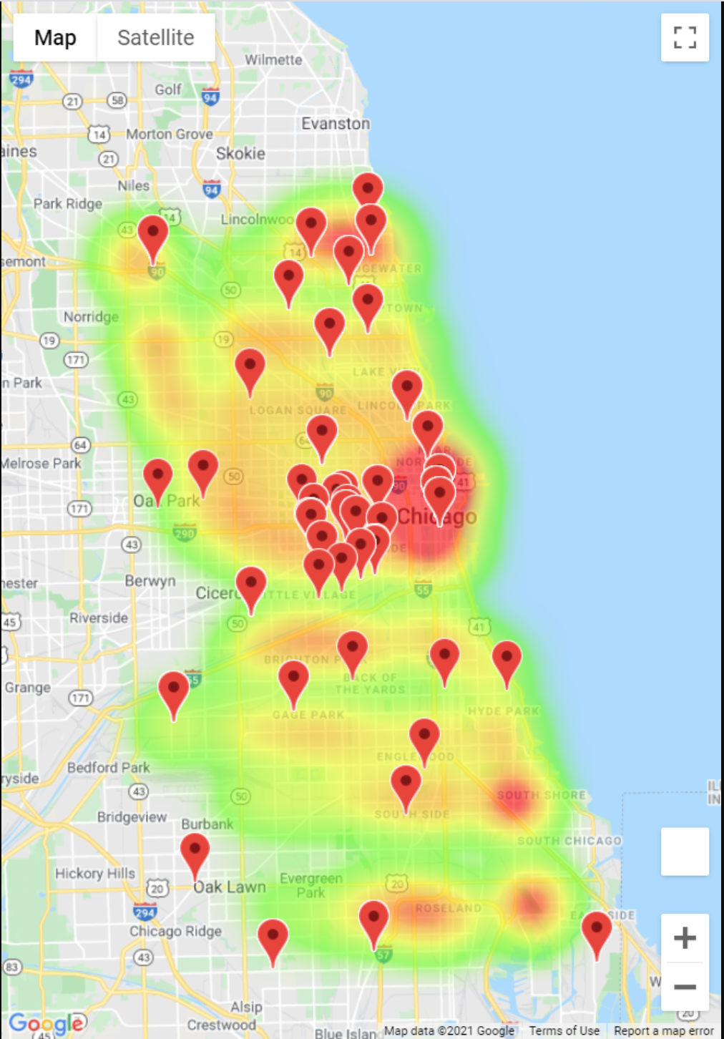
There would be more wrecks around high schools
A heatmap of crash counts by location paired with the location of local high schools shows that although plenty of crashes occur near high schools, there are plenty of locations that experience a high frequency of accidents without a local high school nearby.

Slide 11
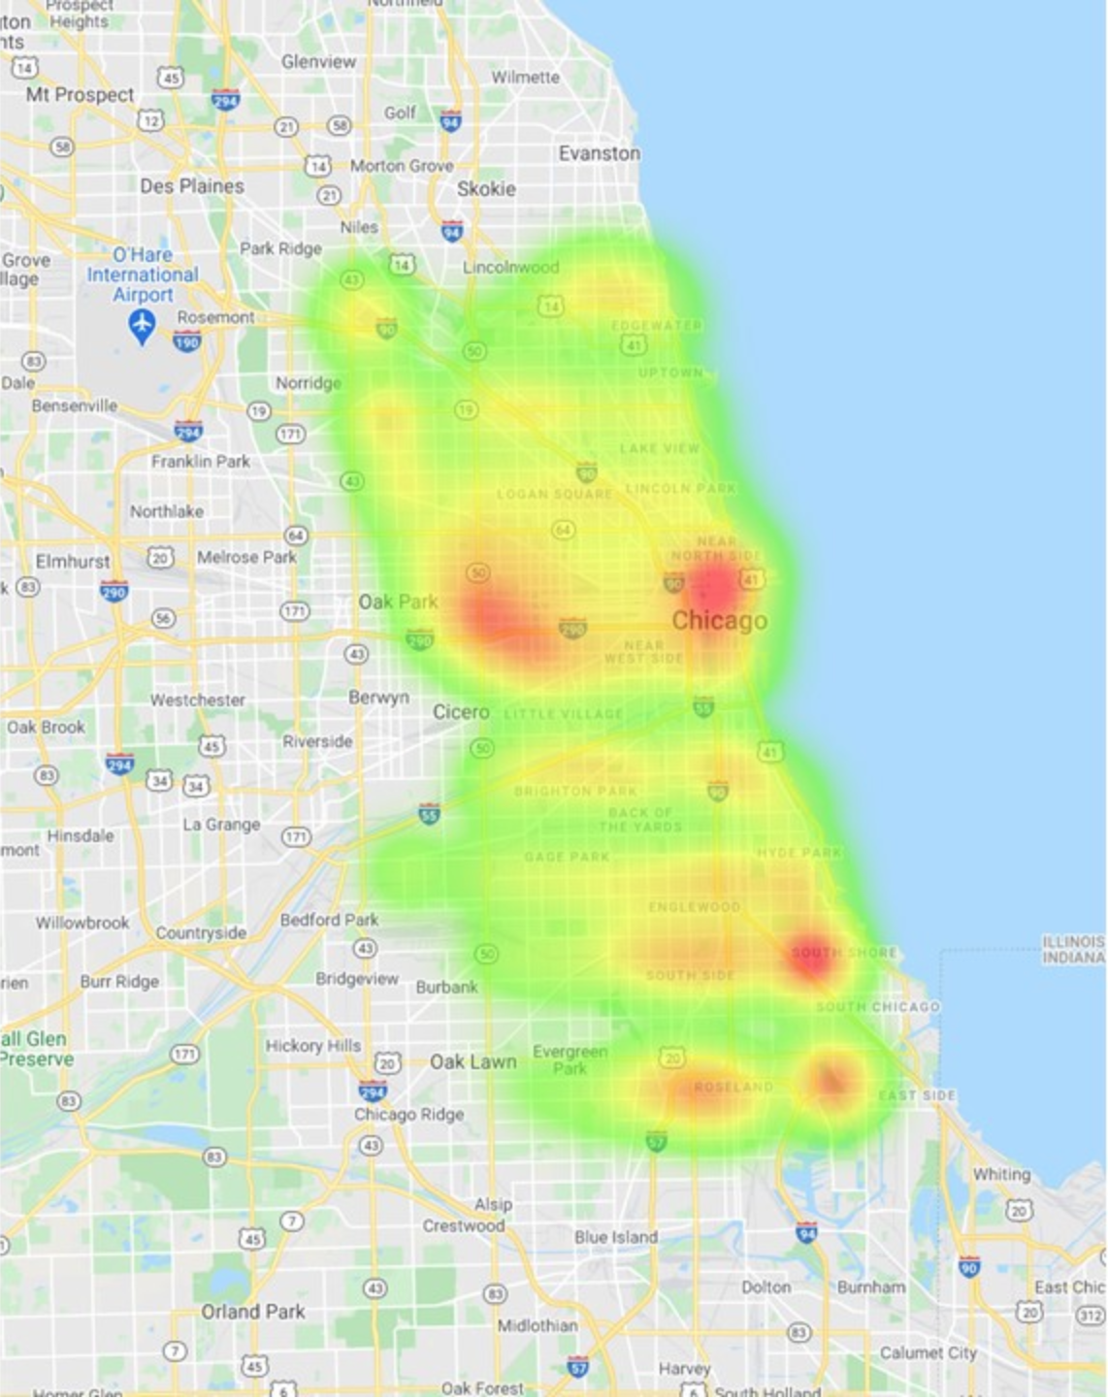
injuries based on location
Injury Heatmap
Red points indicate larger injury count and could be correlated to crash type

Slide 12
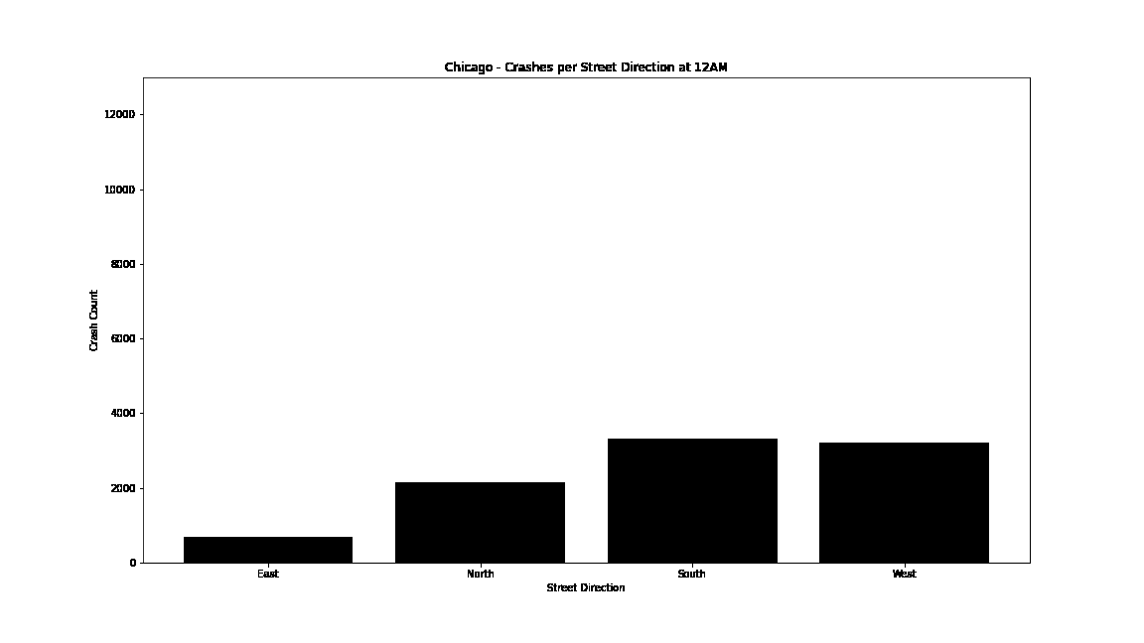
There will be more wrecks facing west towards the sunset
Over 4x more accidents happen on Westbound roads than Eastbound.

Slide 13

Final Thoughts

Slide 14
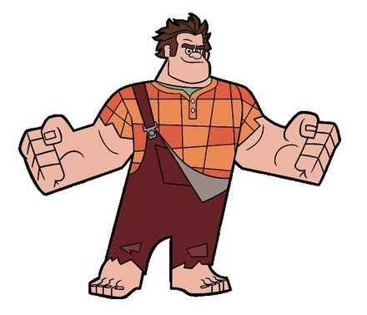
Post mortem
How difficult it was to find data sets that provided enough information to work with
Surprised how many hypotheses turned out to be wrong
Less crashes at night which was opposite of what we initially assumed the data would represent
Could be because there are more cars during the day
We thought time of day would affect crash count (North, East, South, West)
Maybe there are more wrecks in the evening when driving towards the sunset
People are leaving the cost (east) and driving home (west)
Not nearly as many head-on collisions as initially assumed
Perhaps collisions occur more because of carelessness than recklessness

